Slide 1
Hard Particles Oblique Impact
Presented By
Sourit Saha
Summer Intern
IIT Mandi

Slide 2
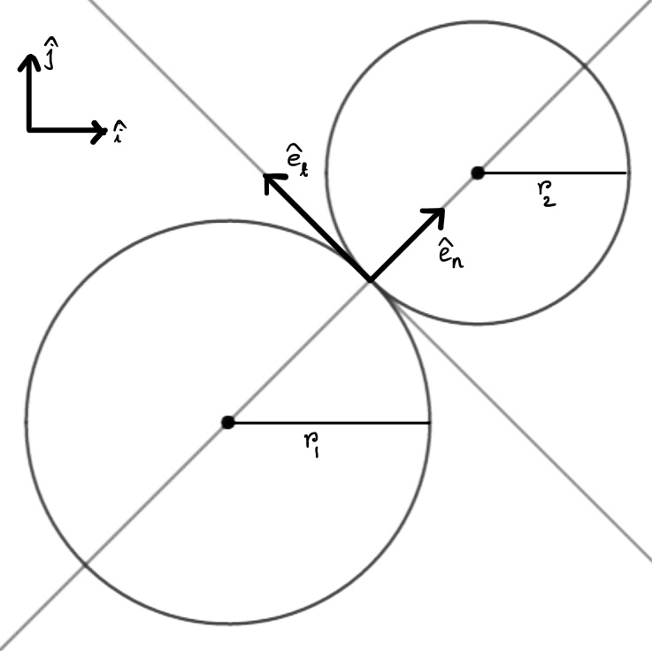
Assumptions and Notations
We will consider only 2D systems.
We will consider only two particles colliding at a time.
Impacting particles will be assumed to be disks of radius r₁ and r₂.
Impacts will be instantaneous as the particles are hard.
Global coordinate system will be denoted as (î, ĵ).
Coordinate system at contact point will be denoted as (ê_{n} , ê_{t}).
ê_{n} denotes the direction normal to the contact surface.
ê_{t} denotes the direction tangential to the contact surface.

Slide 3
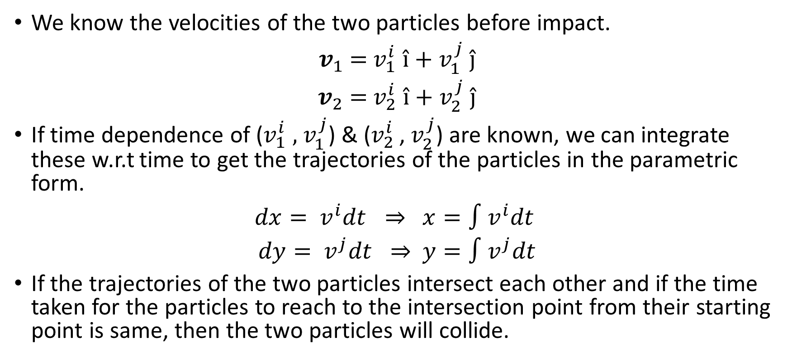
Q. Will the particles collide?
We know the velocities of the two particles before impact.
$v_{1}$ = $v_{1}^{i}$ î + $v_{1}^{j}$ ĵ
$v_{2}$ = $v_{2}^{i}$ î + $v_{2}^{j}$ ĵ
If time dependence of ($v_{1}^{i}$ , $v_{1}^{j}$) & ($v_{2}^{i}$ , $v_{2}^{j}$) are known, we can integrate these w.r.t time to get the trajectories of the particles in the parametric form.
$dx= v^{i}dt ⇒$ $x=\text{∫}v^{i}dt$
$dy= v^{j}dt ⇒$ $y=\text{∫}v^{j}dt$
If the trajectories of the two particles intersect each other and if the time taken for the particles to reach to the intersection point from their starting point is same, then the two particles will collide.

Slide 4
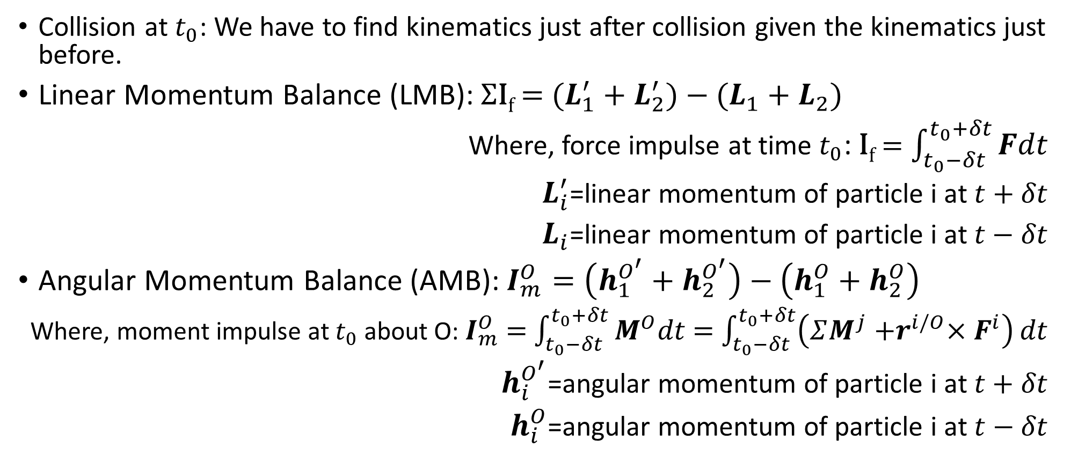
Impulse Momentum Relationship
Collision at $t_{0}$: We have to find kinematics just after collision given the kinematics just before.
Linear Momentum Balance (LMB): ΣI_{f} = ${(L}_{1}^{′} + L_{2}^{′})−(L_{1}+L_{2})$
Where, force impulse at time $t_{0}$: I_{f} = $\int_{t_{0}−δt}^{t_{0}+δt}{Fdt}$
$L_{i}^{′}$=linear momentum of particle i at $t+δt$
$L_{i}$=linear momentum of particle i at$t−δt$
Angular Momentum Balance (AMB): $I_{m}^{O}=\left(h_{1}^{O^{′}}+h_{2}^{O^{′}}\right)−\left(h_{1}^{O}+h_{2}^{O}\right)$
Where, moment impulse at $t_{0}$ about O: $I_{m}^{O}$ = $\int_{t_{0}−δt}^{t_{0}+δt}{M^{O}dt}$ = $\int_{t_{0}−δt}^{t_{0}+δt}{\left(ΣM^{j}{+r}^{i/O}×F^{i}\right)}dt$
$h_{i}^{O^{′}}$=angular momentum of particle i at $t+δt$
$h_{i}^{O}$=angular momentum of particle i at $t−δt$

Slide 5
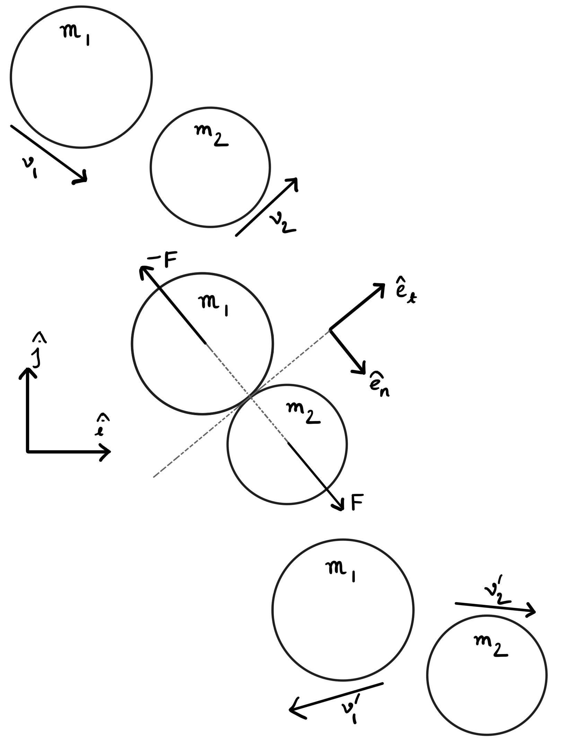
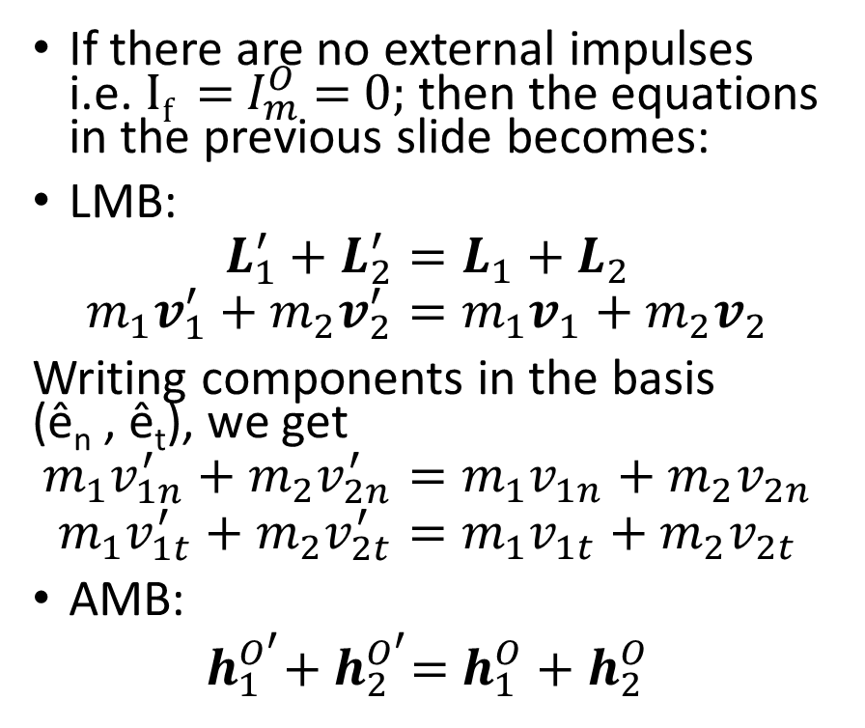
Impulse Momentum Relationship (contd…)
If there are no external impulses i.e. I_{f} = $I_{m}^{O}$ = 0; then the equations in the previous slide becomes:
LMB:
$$L_{1}^{′}+L_{2}^{′}=L_{1}+L_{2}$$
$$m_{1}v_{1}^{′}+m_{2}v_{2}^{′}=m_{1}v_{1}+m_{2}v_{2}$$
Writing components in the basis (ê_{n} , ê_{t}), we get
$$m_{1}v_{1n}^{′}+m_{2}v_{2n}^{′}=m_{1}v_{1n}+m_{2}v_{2n}$$
$$m_{1}v_{1t}^{′}+m_{2}v_{2t}^{′}=m_{1}v_{1t}+m_{2}v_{2t}$$
AMB:
$h_{1}^{O^{′}}$+ $h_{2}^{O^{′}}$= $h_{1}^{O}+h_{2}^{O}$
Before Impact
During Impact
After Impact

Slide 6
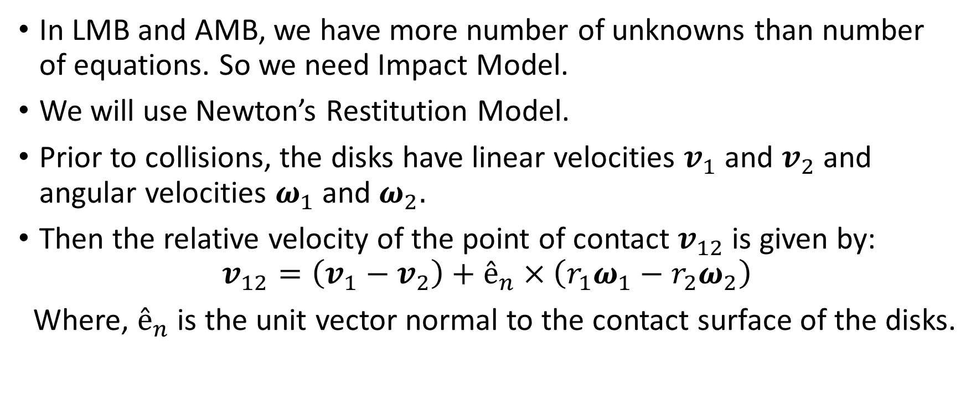
Impact Model
In LMB and AMB, we have more number of unknowns than number of equations. So we need Impact Model.
We will use Newton’s Restitution Model.
Prior to collisions, the disks have linear velocities $v_{1}$ and $v_{2}$ and angular velocities $ω_{1}$ and $ω_{2}$.
Then the relative velocity of the point of contact $v_{12}$ is given by:
$$v_{12}=\left(v_{1}−v_{2}\right)+ê_{n}×\left(r_{1}ω_{1}−r_{2}ω_{2}\right)$$
Where, $ê_{n}$ is the unit vector normal to the contact surface of the disks.

Slide 7
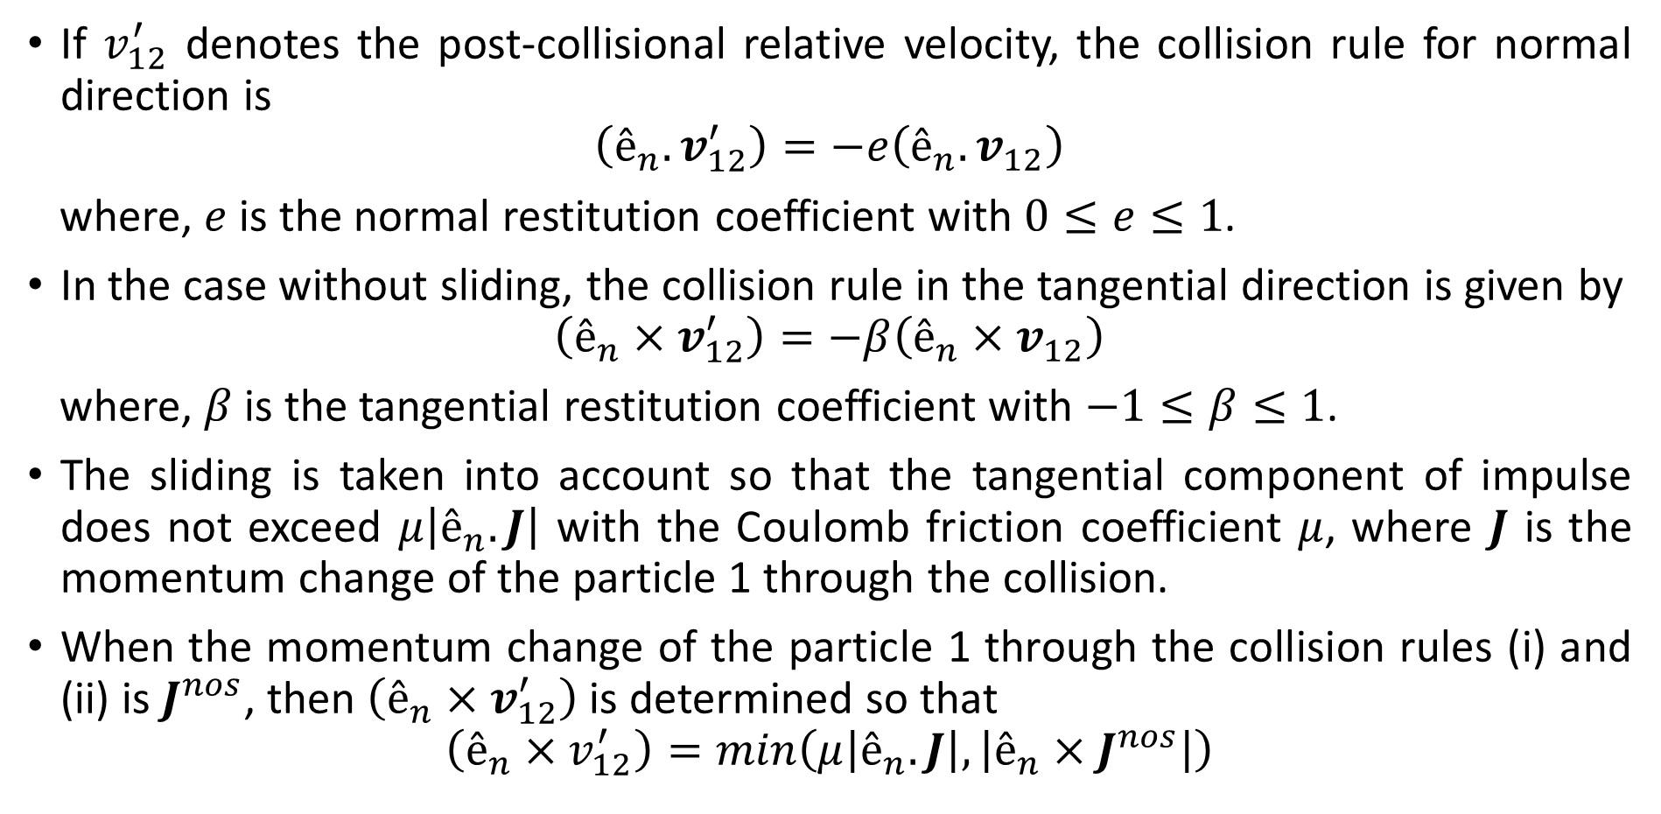
Impact Model (cntd…)
If $v_{12}^{′}$ denotes the post-collisional relative velocity, the collision rule for normal direction is
$$\left(ê_{n}.v_{12}^{′}\right)=−e\left(ê_{n}.v_{12}\right)$$
where, $e$ is the normal restitution coefficient with $0≤e≤1$.
In the case without sliding, the collision rule in the tangential direction is given by
$$\left(ê_{n}×v_{12}^{′}\right)=−β\left(ê_{n}×v_{12}\right)$$
where, $β$ is the tangential restitution coefficient with $−1≤β≤1$.
The sliding is taken into account so that the tangential component of impulse does not exceed $μ\left|ê_{n}.J\right|$ with the Coulomb friction coefficient $μ$, where $J$ is the momentum change of the particle 1 through the collision.
When the momentum change of the particle 1 through the collision rules (i) and (ii) is $J^{nos}$, then $\left(ê_{n}×v_{12}^{′}\right)$ is determined so that
$$\left(ê_{n}×v_{12}^{′}\right)=min\left(μ\left|ê_{n}.J\right|,\left|ê_{n}×J^{nos}\right|\right)$$

Slide 8
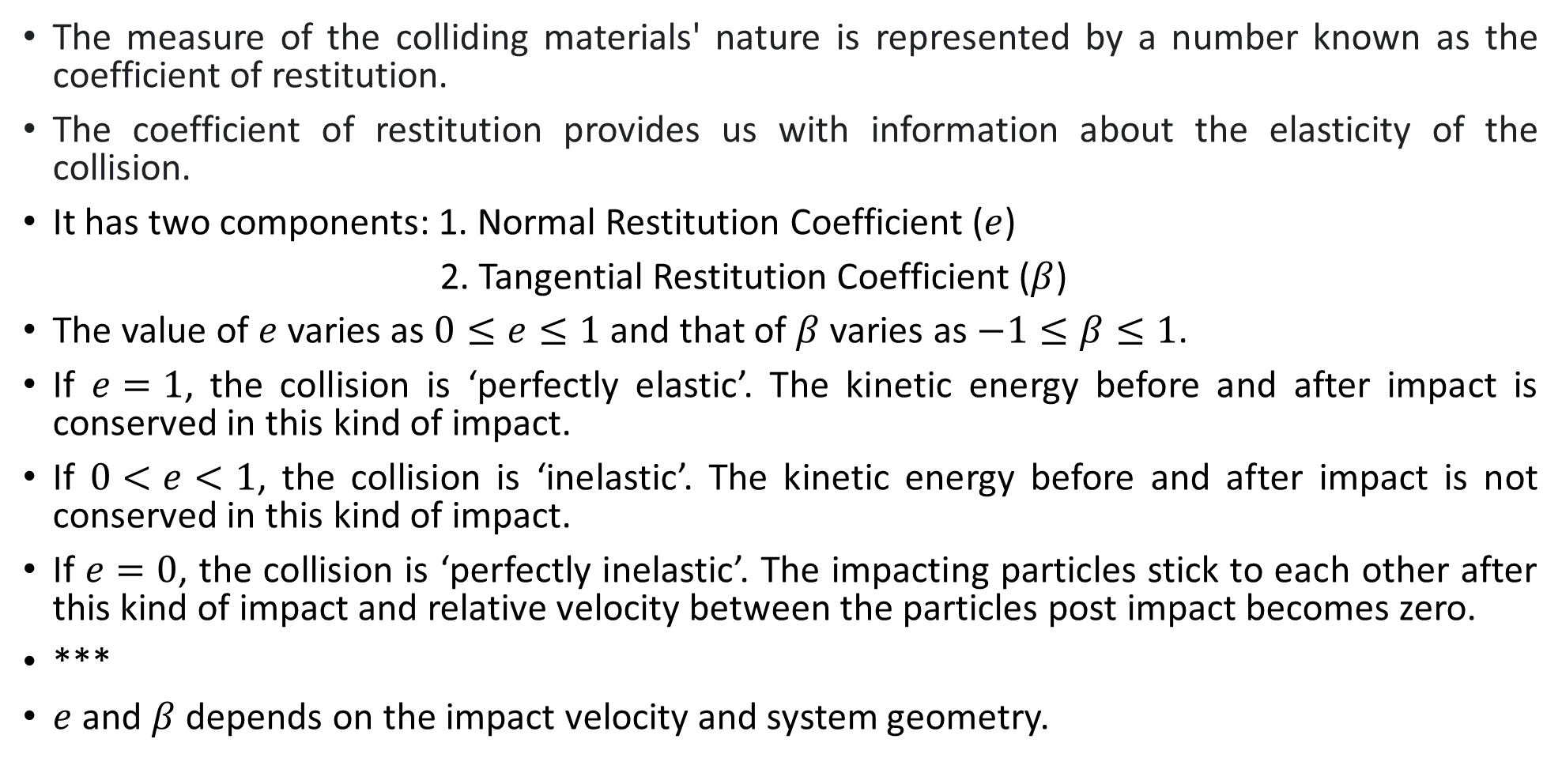
Physical significance of Restitution Coefficients
The measure of the colliding materials' nature is represented by a number known as the coefficient of restitution.
The coefficient of restitution provides us with information about the elasticity of the collision.
It has two components: 1. Normal Restitution Coefficient ($e$)
2. Tangential Restitution Coefficient ($β$)
The value of $e$ varies as $0≤e≤1$ and that of $β$ varies as $−1≤β≤1$.
If $e=1$, the collision is ‘perfectly elastic’. The kinetic energy before and after impact is conserved in this kind of impact.
If $0<e<1$, the collision is ‘inelastic’. The kinetic energy before and after impact is not conserved in this kind of impact.
If $e=0$, the collision is ‘perfectly inelastic’. The impacting particles stick to each other after this kind of impact and relative velocity between the particles post impact becomes zero.
***
$e$ and $β$ depends on the impact velocity and system geometry.

Slide 9
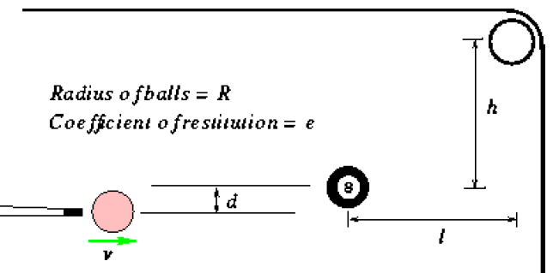
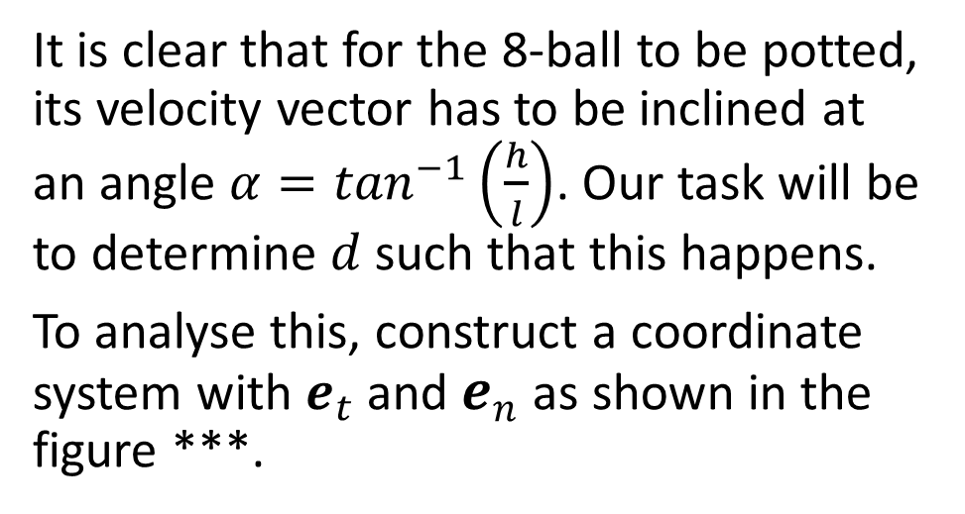
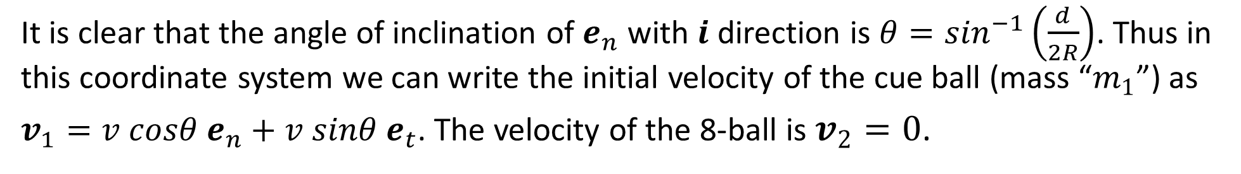
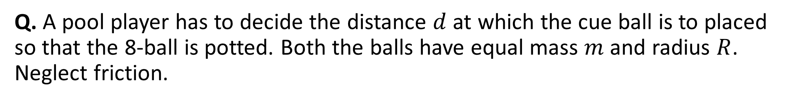
Example: Oblique Impact Numerical Problem
Q. A pool player has to decide the distance $d$ at which the cue ball is to placed so that the 8-ball is potted. Both the balls have equal mass $m$ and radius $R$. Neglect friction.
Soln.
It is clear that for the 8-ball to be potted, its velocity vector has to be inclined at an angle $α=\tan^{−1}\left(\frac{h}{l}\right)$. Our task will be to determine $d$ such that this happens.
To analyse this, construct a coordinate system with $e_{t}$ and $e_{n}$ as shown in the figure ***.
It is clear that the angle of inclination of $e_{n}$ with $i$ direction is $θ=\sin^{−1}\left(\frac{d}{2R}\right)$. Thus in this coordinate system we can write the initial velocity of the cue ball (mass “$m_{1}$”) as
$v_{1}=v cosθ e_{n}+v sinθ e_{t}$. The velocity of the 8-ball is $v_{2}=0$.

Slide 10
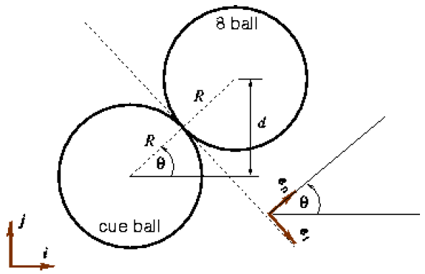
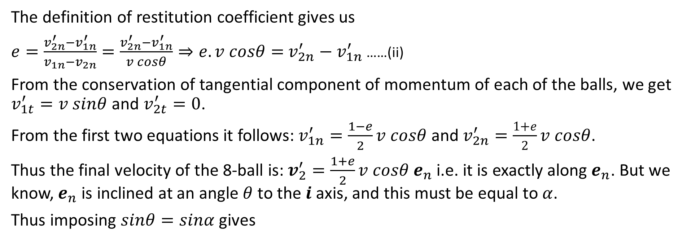

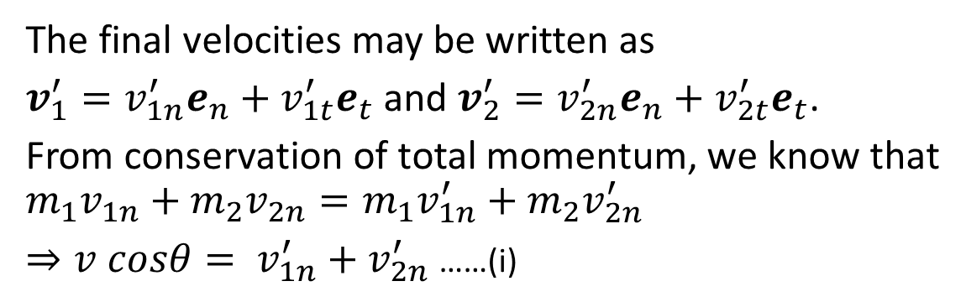
Example: Oblique Impact Numerical Problem (contd…)
The final velocities may be written as
$v_{1}^{′}=v_{1n}^{′}e_{n}+v_{1t}^{′}e_{t}$ and $v_{2}^{′}=v_{2n}^{′}e_{n}+v_{2t}^{′}e_{t}$.
From conservation of total momentum, we know that
$$m_{1}v_{1n}+m_{2}v_{2n}=m_{1}v_{1n}^{′}+m_{2}v_{2n}^{′}$$
$⇒v cosθ= v_{1n}^{′}+v_{2n}^{′}$ ……(i)
The definition of restitution coefficient gives us
$e=\frac{v_{2n}^{′}−v_{1n}^{′}}{v_{1n}−v_{2n}}=\frac{v_{2n}^{′}−v_{1n}^{′}}{v cosθ}⇒e.v cosθ=$ $v_{2n}^{′}−v_{1n}^{′}$ ……(ii)
From the conservation of tangential component of momentum of each of the balls, we get $v_{1t}^{′}=v sinθ$ and $v_{2t}^{′}=0$.
From the first two equations it follows: $v_{1n}^{′}=\frac{1−e}{2}v cosθ$ and $v_{2n}^{′}=\frac{1+e}{2}v cosθ$.
Thus the final velocity of the 8-ball is: $v_{2}^{′}=\frac{1+e}{2}v cosθ e_{n}$ i.e. it is exactly along $e_{n}$. But we know, $e_{n}$ is inclined at an angle $θ$ to the $i$ axis, and this must be equal to $α$.
Thus imposing $sinθ=sinα$ gives
$$d=\frac{2Rh}{\sqrt{l^{2}+h^{2}}}$$

Slide 11
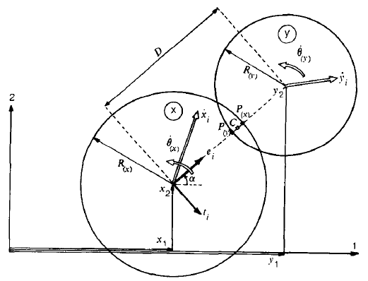
Comparison between Hard and Soft Particle Impact
Hard Particle Impact
Soft Particle Impact
In hard particle impact, the impact is instantaneous.
There is no local deformation at the contact point of the particles in hard particle impact.
Momentum balance equations (LMB, AMB) are the primary equations to solve this problem.
In soft particle impact, the impact is not instantaneous.
Local deformation and overlapping happens at the contact of the particles in soft particle impact.
Force-displacement equations are the primary equations to solve this problem.

Slide 12
Thank you!

